Slide 1
Introduction to Linear Algebra
선형대수학개론
Syllabus
강의 계획표
by 조범희 Bumhee Cho

Slide 2
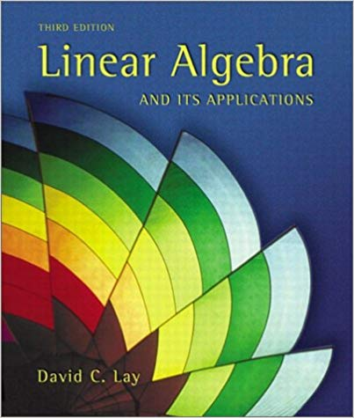
This course
Language: 한국어, but terminology in English
Reference textbook: Linear Algebra and Its Applications, 3rd Ed., D. C. Lay, (2003).
Prerequisite: (Korean) High school math
Level:
University
14 ~ 18 weeks
Extensive examples
Instructor:
Bumhee Cho, graduated KAIST
Full time (!)
Q & A space
bumhee34@kaist.ac.kr / bumhee34@gmail.com
Slack channel

Slide 3
Do I need this course?
Must-have course for 공대생
복습하고자하는 대학원생
취미로 대학 수학을 배우고 싶다!
카이스트의 수준이 궁금하다!
Programmer

Slide 4
We will cover
Linear Equations in Linear Algebra
Matrix Algebra
Determinants
Vector Spaces
Eigenvalues and Eigenvectors
Orthogonality and Least Squares
Symmetric Matrices and Quadratic Forms
week 1 - 2
week 3 - 4
week 5 - 6
week 6 - 8
week 8 - 10
week 11 - 12

Slide 5
Let’s make this course together!

